Slide 1
Nonlinear Systems of Equations

Slide 2
Solving Nonlinear Systems of Equations

Slide 3
Solving Nonlinear Systems of Equations
A nonlinear system of equations is one in which one or
more equations of the system are not linear equations.
In this section, we will only consider solutions whose coordinates are real numbers.
Therefore, if a system of equations does not have any solution in which both coordinates are real numbers, we will simply state that the system has no solution.

Slide 4
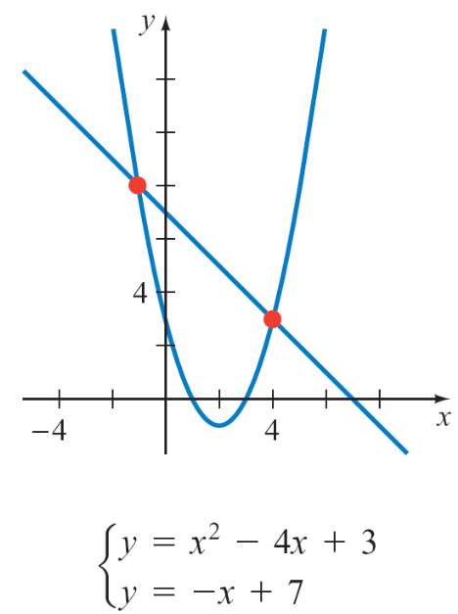
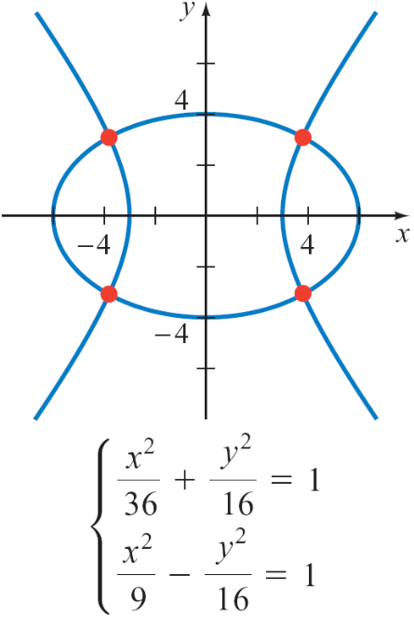
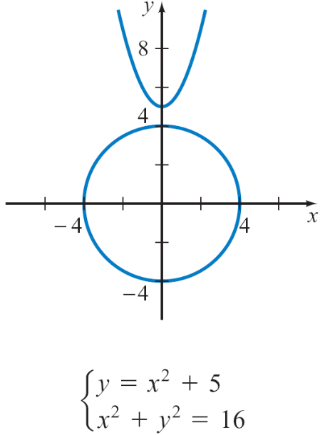
Solving Nonlinear Systems of Equations
Figure 9.17 shows examples of nonlinear systems of equations and the corresponding graphs of the equations.
Two solutions
Four solutions
No solutions
Figure 9.17

Slide 5
Solving Nonlinear Systems of Equations
Each point of intersection of the graphs is a solution of the
system of equations. In the third example, the graphs do
not intersect; therefore, the system of equations has no
solution.
To solve a nonlinear system of equations, use the substitution method or the elimination method.
The substitution method is usually easier for solving a nonlinear system that contains a linear equation.

Slide 6

Example 1 – Solve a Nonlinear System by the Substitution Method
y = x² – x – 1 (1)
3x – y = 4 (2)
Solution:
We will use the substitution method. Using the equation
y = x² – x – 1, substitute the expression for y into
3x – y = 4.
3x – y = 4
3x – (x² – x – 1) = 4
–x² + 4x + 1 = 4
Solve:
y = x² – x – 1
Simplify.

Slide 7
Example 1 – Solution
cont’d
Write the quadratic equation
in standard form.
x² – 4x + 3 = 0
(x – 3)(x – 1) = 0
x – 3 = 0 or x – 1 = 0
x = 3 or x = 1
Substitute these values into Equation (1) and solve for y.
y = 3² – 3 – 1 = 5 or y = 1² – 1 – 1 = –1
The solutions are (3, 5) and (1, –1).
Check by showing that (3, 5) and (1, –1) satisfy both equations in the original system.
Solve for x.

Slide 8
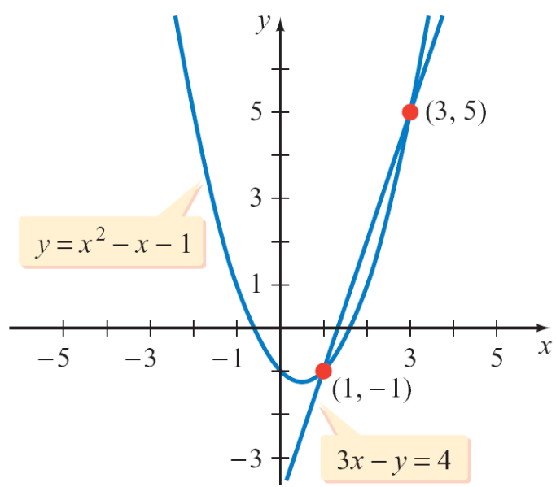
Example 1 – Solution
cont’d
Graphing y = x² – x – 1 and 3x – y = 4 shows that the
points located at (1, –1) and (3, 5) belong to each graph.
Therefore, these ordered pairs are the solutions of the
system of equations.

